Slide 1
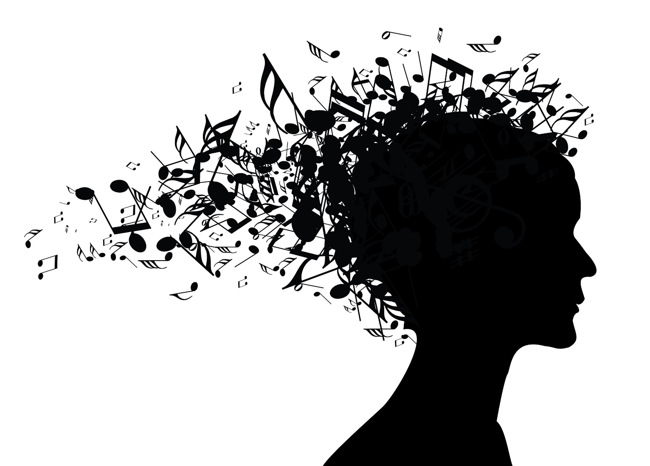
Generating Music with LSTM
MSBA7011 Managing and Mining Big Data Audiophile

Slide 2

Objective
Data
Modeling
Results
Conclusion
Appendix

Slide 3
Objective
Pick one artist, and use his songs as training data
Generate new music using LSTM model.
The model should generate new music in the style of that artist
Our goal:

Slide 4
Objective
Data
Modeling
Results
Conclusion
Appendix

Slide 5
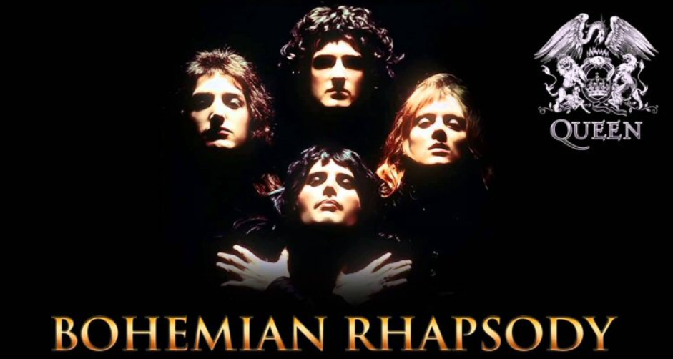
Data
Queen
One of the most famous band in the world. Members: Freddie Mercury, Brian May, Roger Taylor, John Deacon

Slide 6
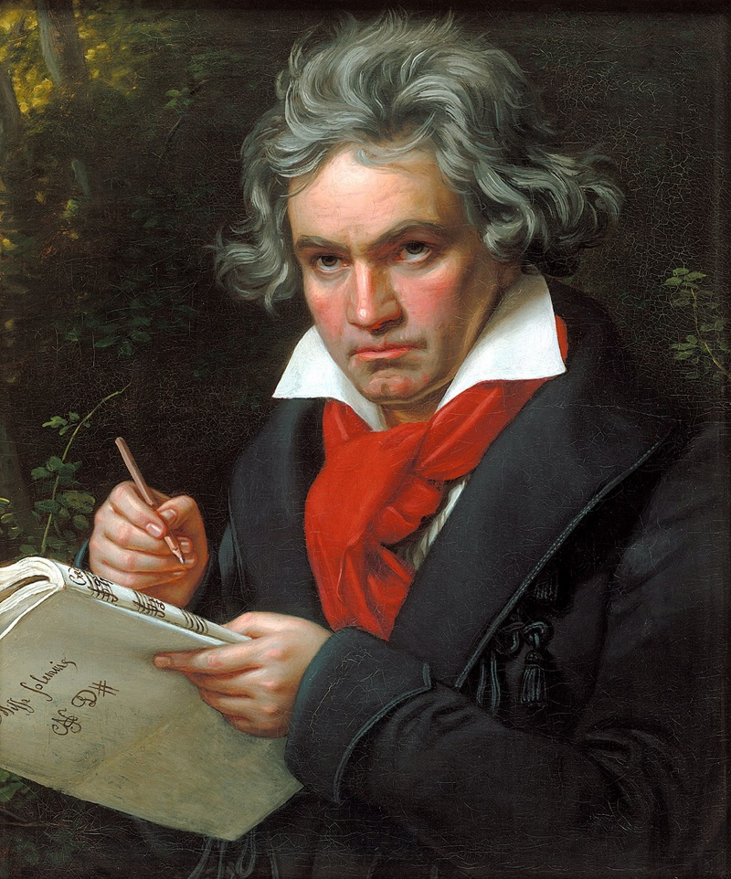
Data
Ludwig van Beethoven
Composer and Pianist The man and the artist, as revealed in his own words

Slide 7
Objective
Data
Modeling
Results
Conclusion
Appendix

Slide 8
Process
Modeling
Convert music information into numerical data (music21)
Notes, chords, pitch, octave, offsets, rest, instruments, etc.
Define starting point and ending objective
Input: sets of sequence of 100 notes/chords
Output: 500 notes/chords
Train RNN with LSTM (Google Colaboratory)
Predominantly 2 layers (due to time)
Generate music with RNN
Set random note to start
Notes:
Make dictionary of where keys = notes and value = numerical value that represents the key
Sequence = 100 because instruments are relatively repetitive (for queen and Beethoven) (enough/ lack of domain knowledge)
Normalize input, and one-hot encode output

Slide 9
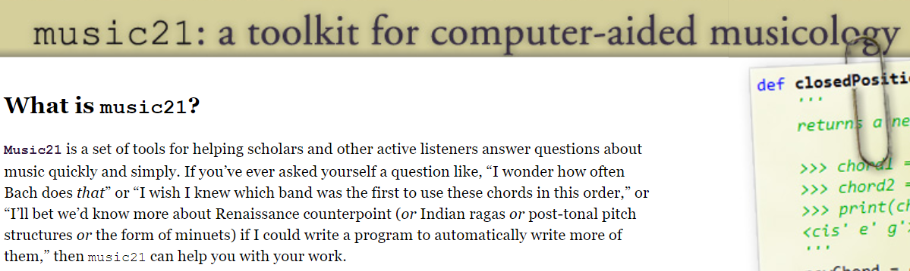
Data
music21
The package we use to handle music data

Slide 10
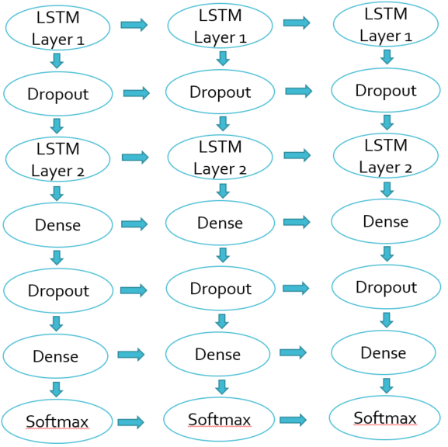
Two Layer Architecture
Modeling
Softmax
Softmax
Softmax

Slide 11
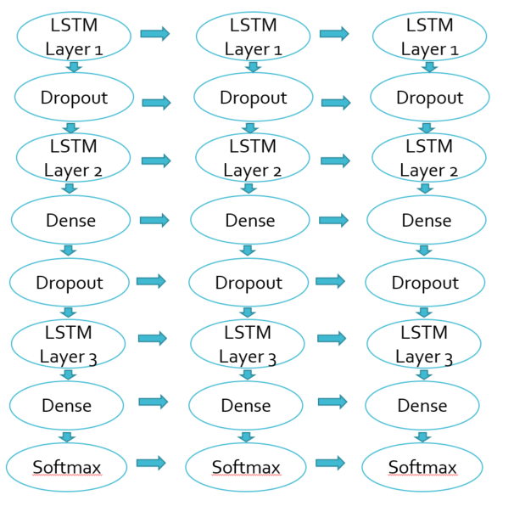
Three Layer Architecture
Modeling
Softmax
Softmax
Softmax

Slide 12
Objective
Data
Modeling
Results
Conclusion
Appendix

Slide 13
Results
2 Layers
Full Midi File
The outcome will be a piano piece based on all the instruments used in the songs
Queen’s
results:

Slide 14

10 epochs was not enough…
Results - Queen
Notes:
10 epochs was not enough to identify significant patterns within the sequences of notes

Slide 15
40 epochs yielded more than one note…
Results - Queen
Notes:
There are other notes in this, but it will eventually get stuck when it reaches a very unusual note

Slide 16
100 epochs becomes more complex…
Results - Queen
Notes:
Able to create a comprehensive sequence of notes
Because it was looking at the vector of all the instruments combined, the result is interpreted as an acoustic/piano version of a song

Slide 17
Results
2 Layers
Pure piano input
Changed tempo (200 epoch)
The model is writing a piano piece based on other piano pieces
Beethoven
results:
Notes:
More simplistic/ uni- dimensional data
Theme of music is the same, and the role of piano did not change

Slide 18
100 epochs…
Results - Beethoven
Notes:
Sounded a bit mysterious, dark, almost unnatural

Slide 19
200 epochs with manual change in tempo…
Results - Beethoven
Notes:
More epochs, more comprehensive
When sped up, it seems like the notes are unified and sounded like a Beethoven song

Slide 20
Objective
Data
Modeling
Results
Conclusion
Appendix

Slide 21
Reflection:
Conclusion
Data processing is key
Identify parts of music
Identify role of instrument
Consider the type of music
Notes:
1. timing, and rhythm and one instrument
Normalize input, and one-hot encode output
2. Chorus, verse, etc.
3.

Slide 22
Future Improvements
Conclusion
Generative Adversarial Networks (GAN)
Implementation of rhythm
Incorporate more instruments
Reinforcement learning
Separate models for unique genres
Notes:
Make dictionary of where keys = notes and value = numerical value that represents the key
Sequence = 100 because instruments are relatively repetitive (for queen and Beethoven) (enough/ lack of domain knowledge)
Normalize input, and one-hot encode output

Slide 23
Application
Conclusion
Background music generator
Game music
Stock music
Store Music
Assisted creativity
Notes:
Make dictionary of where keys = notes and value = numerical value that represents the key
Sequence = 100 because instruments are relatively repetitive (for queen and Beethoven) (enough/ lack of domain knowledge)
Normalize input, and one-hot encode output

Slide 24
Objective
Data
Modeling
Results
Conclusion
Appendix

Slide 25
Work Cited
Appendix
http://www.piano-midi.de/beeth.htm
http://tomqueen.tripod.com/midis.html
https://towardsdatascience.com/how-to-generate-music-using-a-lstm-neural-network-in-keras-68786834d4c5
https://blog.floydhub.com/generating-classical-music-with-neural-networks/
https://www.google.com/url?sa=t&rct=j&q=&esrc=s&source=web&cd=2&cad=rja&uact=8&ved=2ahUKEwiVvqKO6-zgAhXOdN4KHUVgD1QQFjABegQIGxAC&url=https%3A%2F%2Farxiv.org%2Fpdf%2F1804.07300&usg=AOvVaw2Jxr__aIttKMfzfpzQRgf3
https://medium.com/datadriveninvestor/music-generation-using-deep-learning-85010fb982e2

Slide 26
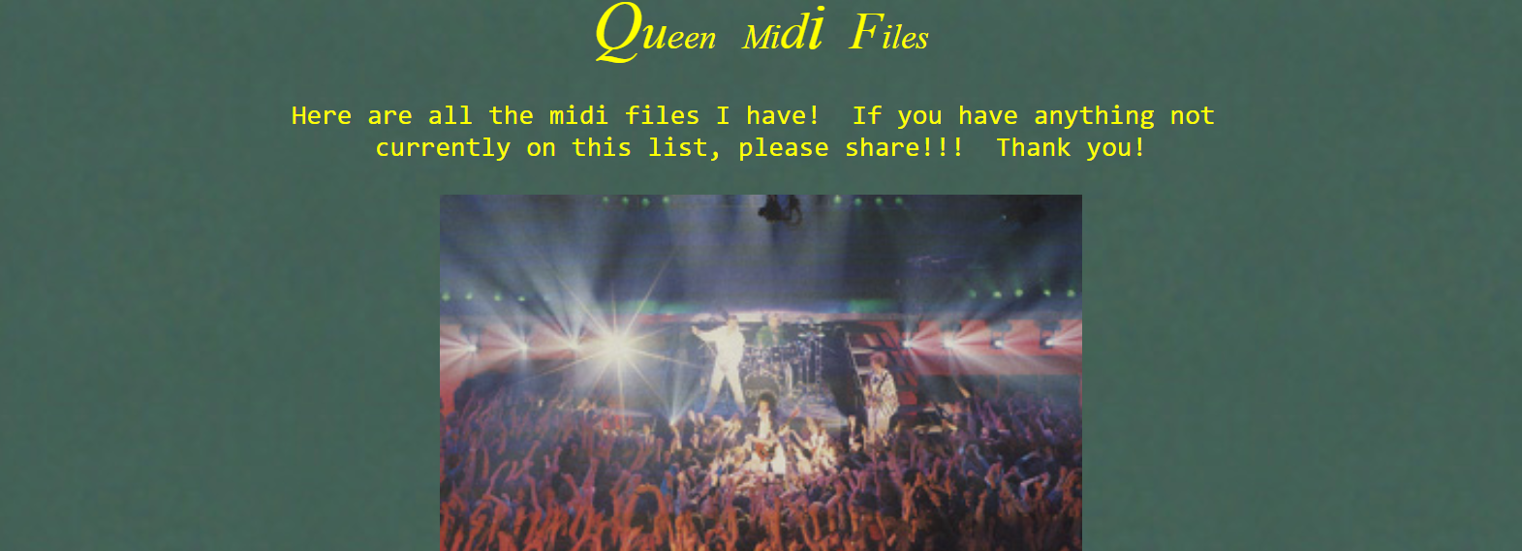
Appendix
We download data from:
http://tomqueen.tripod.com/midis.html Use 11x Queen’s midi songs as input data

